Slide 1

GOVERNOR'S CHALLENGE
BANK OF CANADA
3 | GLOBAL ECONOMY

Slide 2

Introduction and Recommendation
Hold target rate at 5%
OUR POLICY RECOMMENDATION

Slide 3

Outline
V. Labour Strikes
IV. Food CPI
VI. Inflation Expectations
III. Primary Drivers of Inflation
VII. Statistical Modelling
II. Economy Overview
VIII. Risks
I. Introduction
IX. Q&A
OUTLINE
Notes:
pass through inflation

Slide 4

Economy Overview

Slide 5
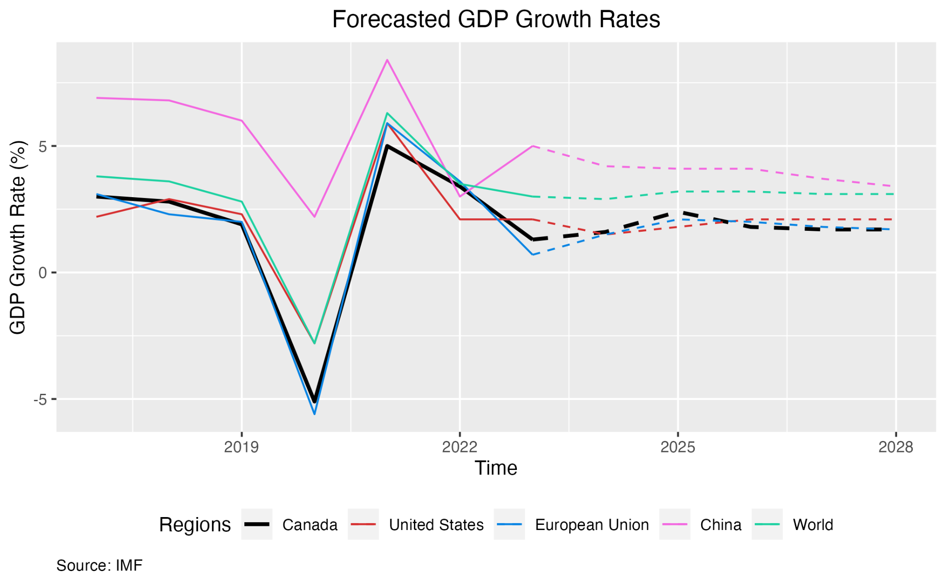
In 2024, Canadian GDP is expected to fall by 0.30%, but there still remains a supply-demand gap
Unemployment increased slightly. Labor vacancy rate has fallen to 4.6% but still hasn’t reached pre-pandemic levels
Headline inflation has fallen but core inflation is still sticky. Demand will dampen across the world
Canadian and Global Economy
CANADIAN & GLOBAL ECONOMY OVERVIEW
Notes:
Real GDP growth Annual percent change and Contributions to average annual real GDP growth

Slide 6
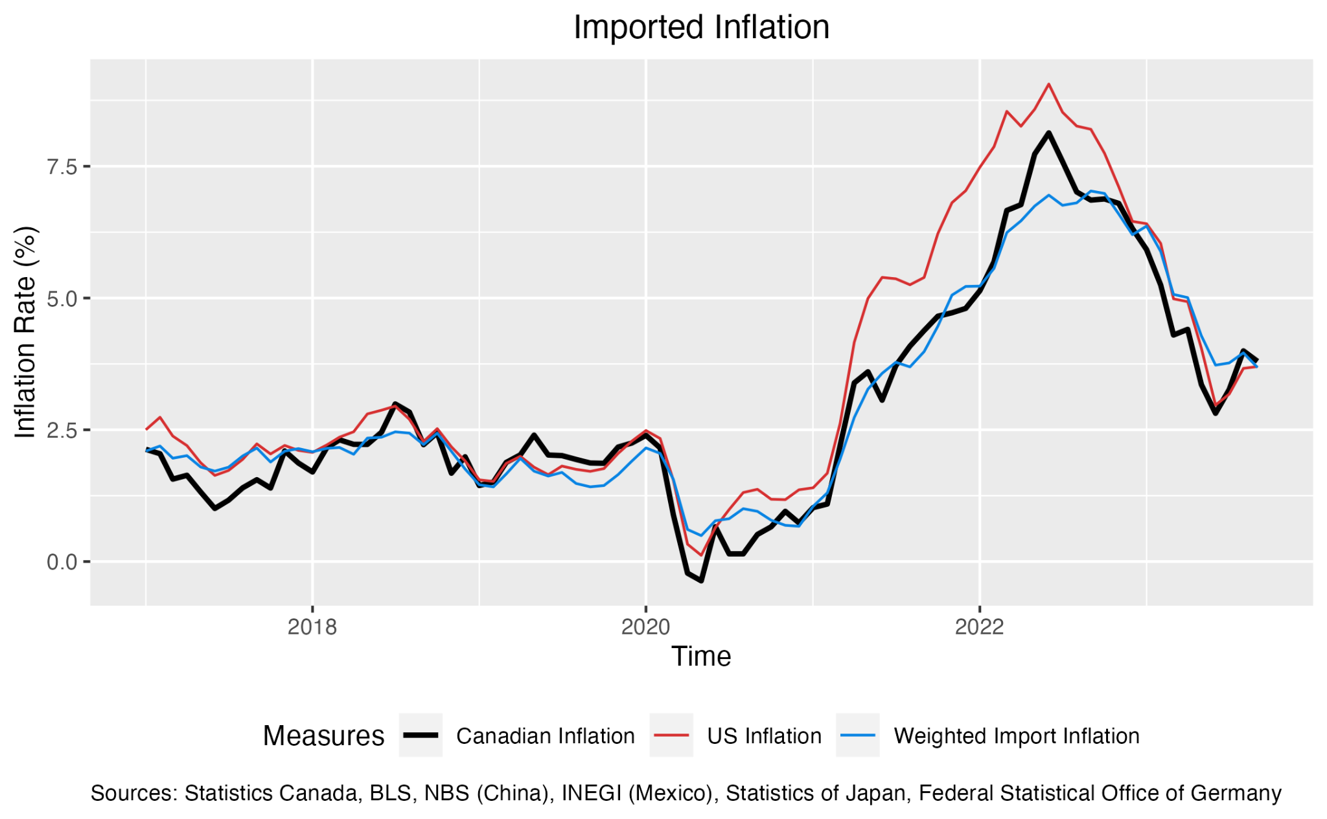
Weighted import inflation rate of five major import partners
United States
China
Mexico
Germany
Japan
Weights calculated using linear regression with sum of coefficients equal to 1
Weighted import inflation is still higher than pre-pandemic levels
Import-Push Inflation
IMPORT-PUSH INFLATION

Slide 7
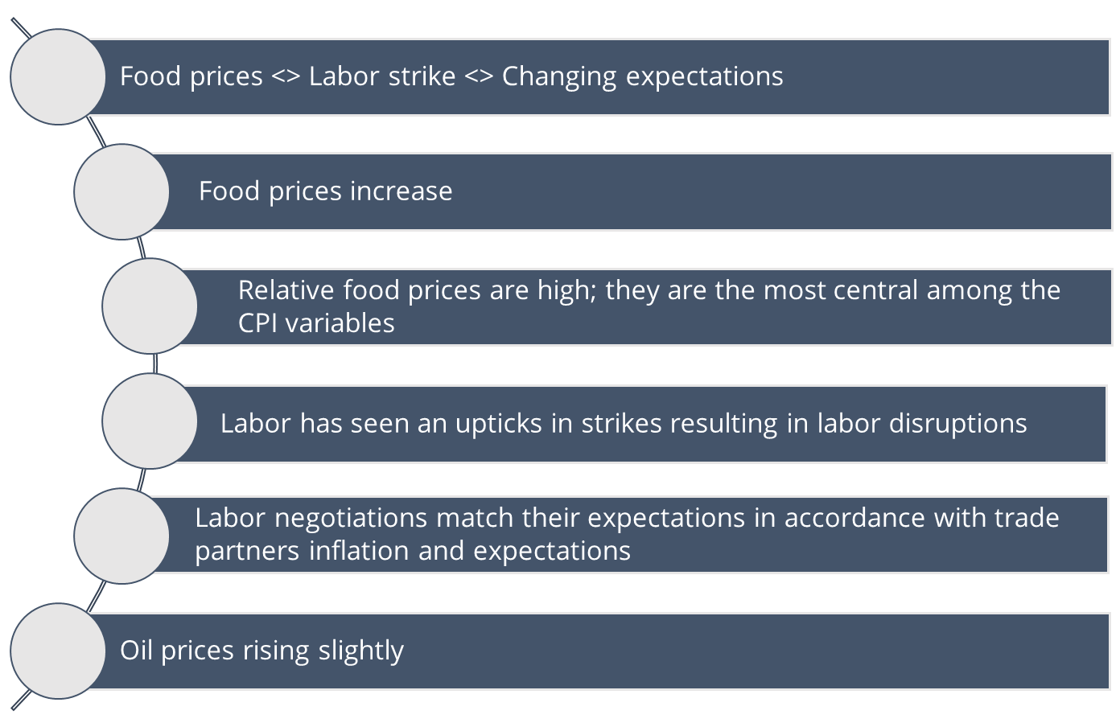






Primary Drivers of Inflation
PRIMARY DRIVERS OF INFLATION

Slide 8
Food CPI

Slide 9
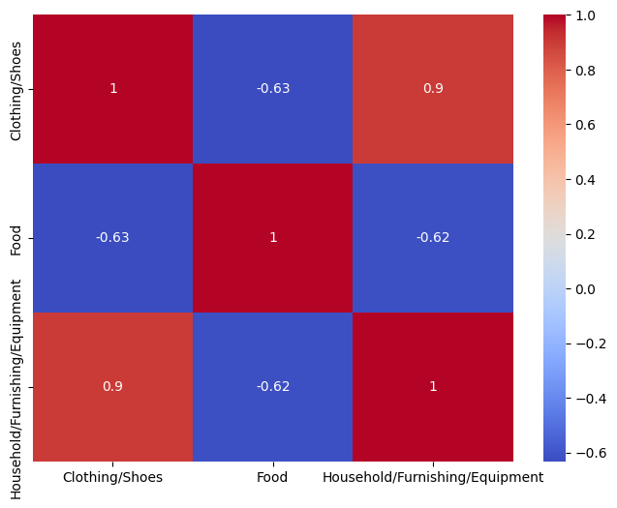
Take correlation matrix of CPI categories
Define high, positive correlation (red) as connected
Use centrality mapping algorithm
CPI Categories Decomposition
Positive Correlation
Negative
Correlation
CPI CATEGORIES DECOMPOSITION

Slide 10
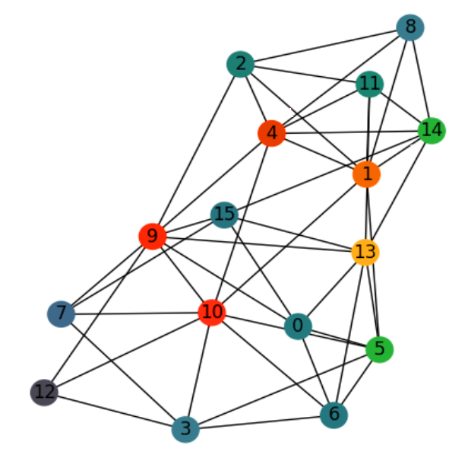
Category Mapping
CPI Categories Legend
10 | Food
9 | Transportation
1 | Clothing/footwear
5 | Recreation, education, reading
14 | Shelter
0 | Alcohol, tobacco, cannabis
12 | Household, furnishing, equipment
Most Central
0
1
2
4
5
Least Central
MAPPING CPI CATEGORIES

Slide 11
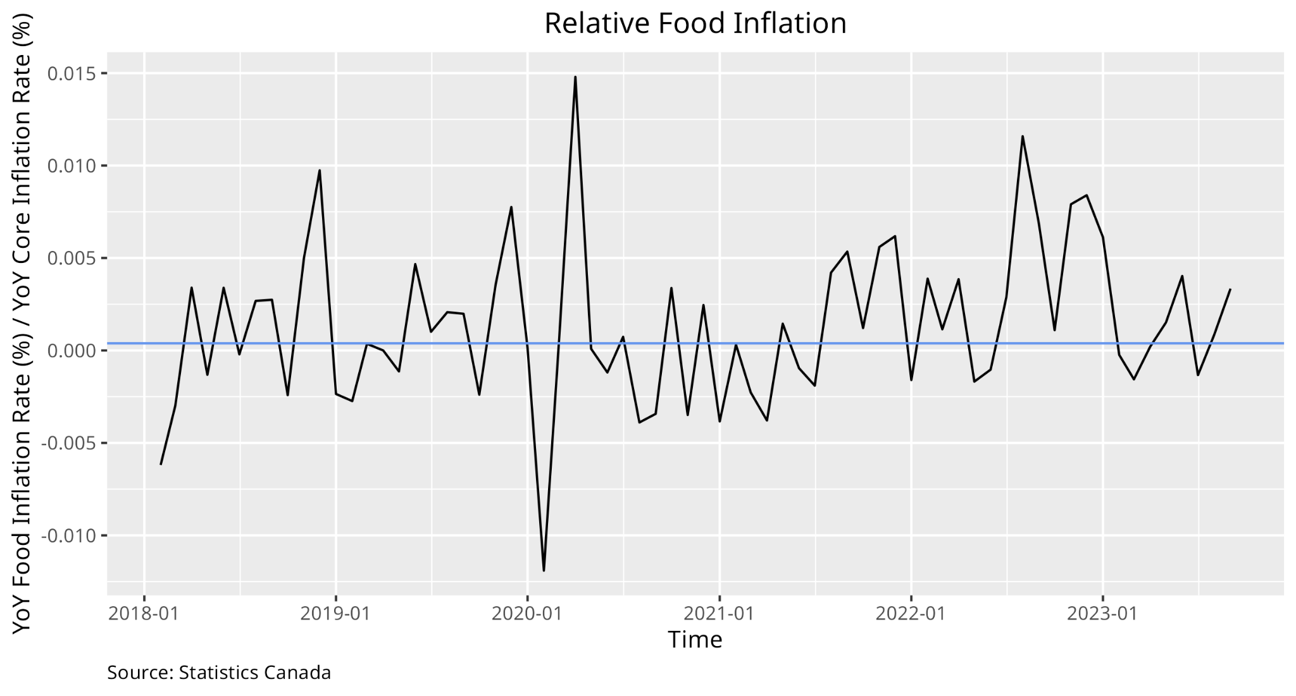
We examine the ratio of food inflation rate to core CPI inflation rate
Since 2020, this ratio has largely remained well above the pre-pandemic median (0.00039)
Relative Food Inflation Remains High
LABOUR STRIKE INDEX

Slide 12
Labour Strikes

Slide 13
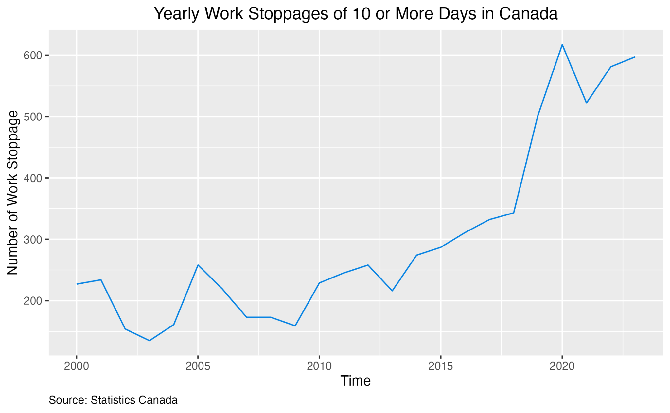
2023 has had the most labour disruptions in Canada since 2000 (except 2020)
Labour Action in Canada is High
LABOUR STRIKE INDEX

Slide 14
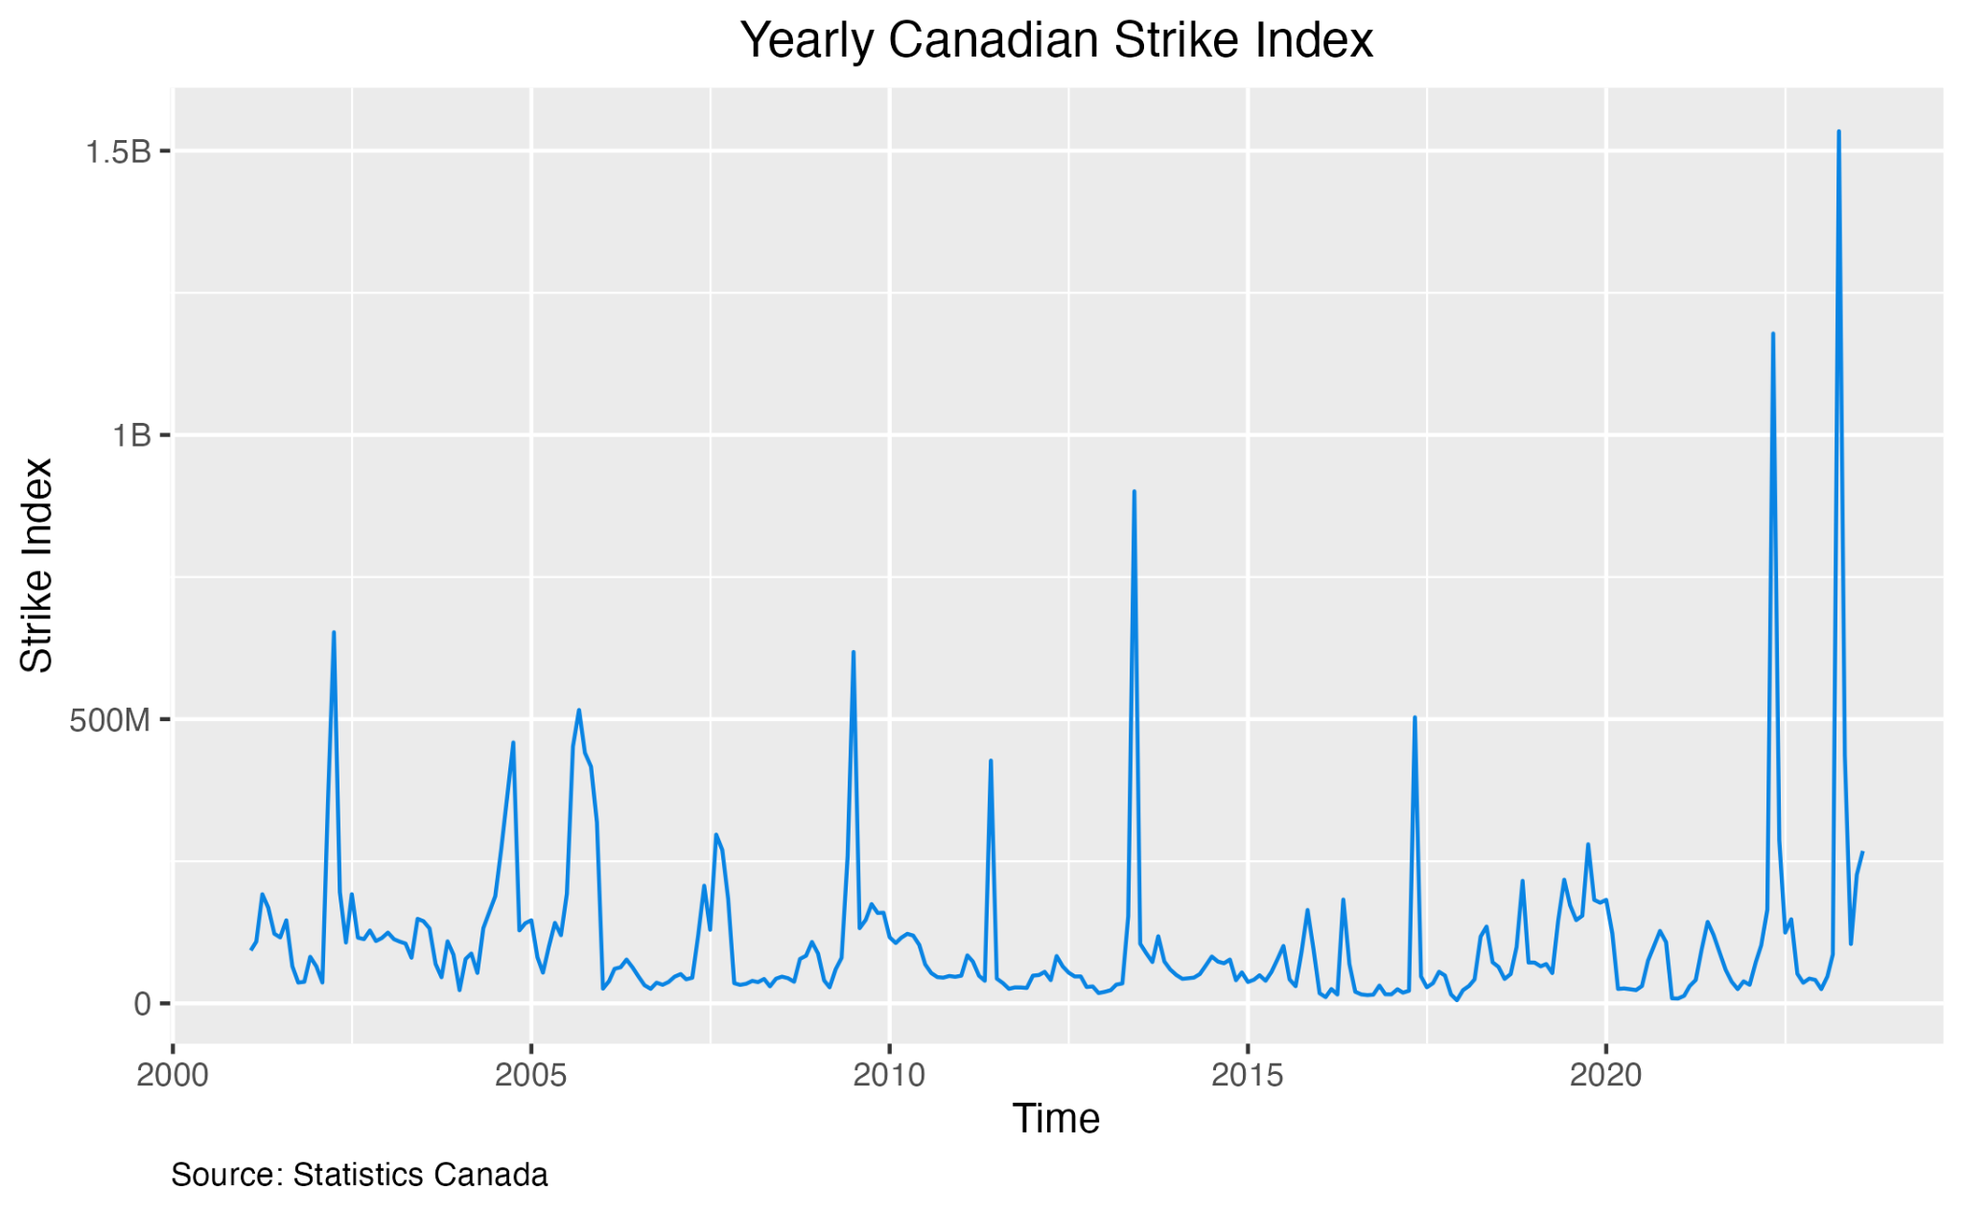
We devise a yearly strike index metric to capture labour action severity
Person-days lost to labour action in a given year, weighted by the average wage of the industry of that lost person-day
Two highest strike index years since 2000 are 2020 and 2022
Canadian Strike Index
LABOUR STRIKE INDEX

Slide 15
Expectations

Slide 16
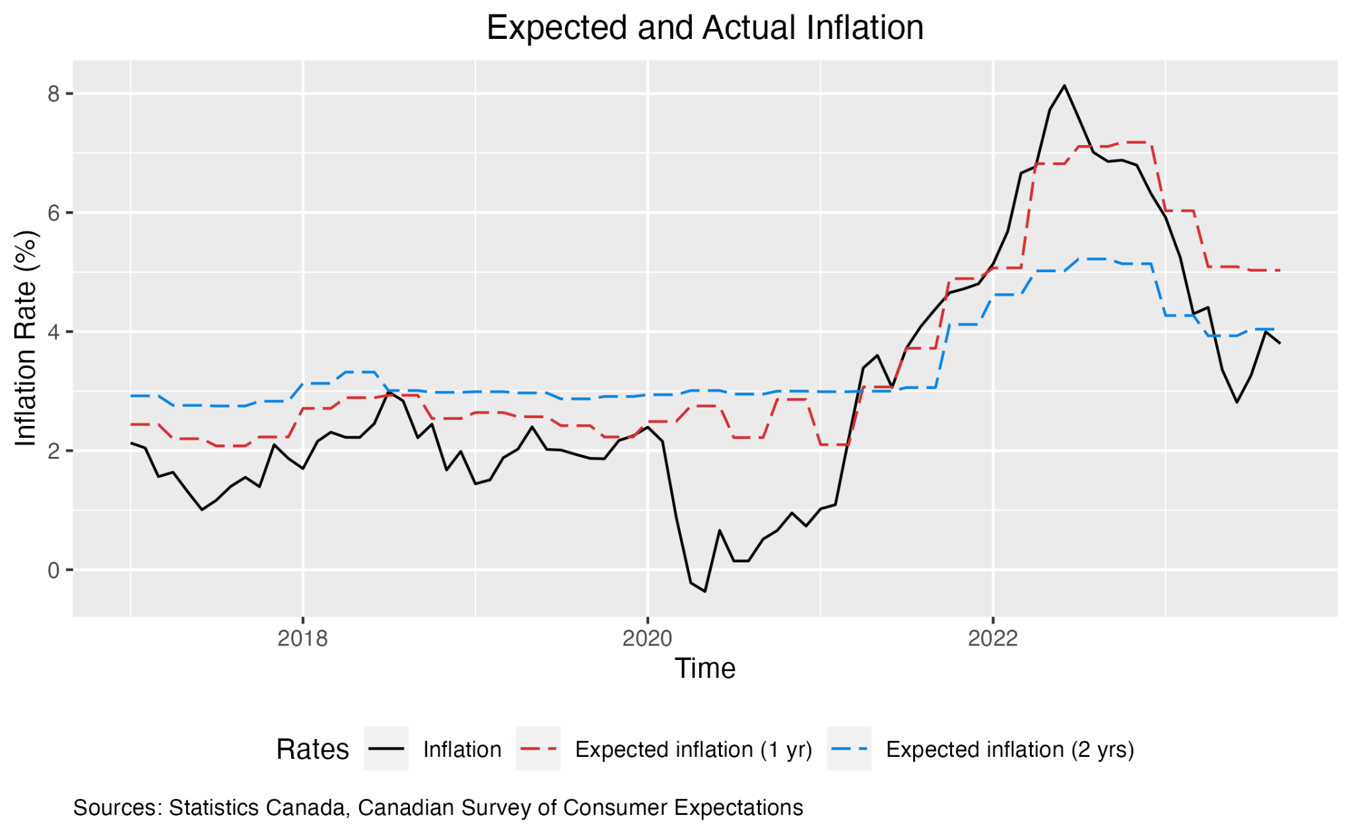
Consumer Inflation Expectations
Inflation expectations and actual inflation rate are strongly, positively correlated
Expectations remain above pre-pandemic levels
CONSUMER INFLATION EXPECTATIONS

Slide 17

Statistical Modelling

Slide 18
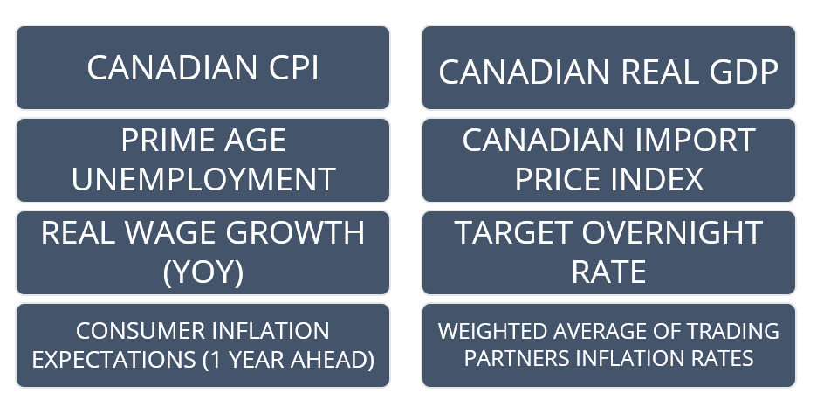
VAR Variables
VAR MODEL COMPONENTS

Slide 19
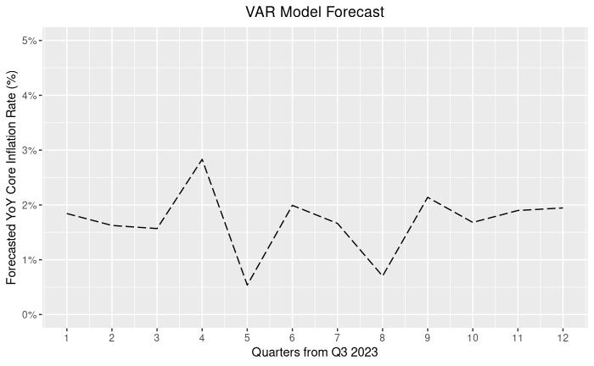
Inflation falls rapidly to just below 2% by Q4 2023
It then fluctuates over the projected period, but largely remains within the target range of 2% +/- 1%
VAR Model: Results
VAR MODEL - RESULTS

Slide 20
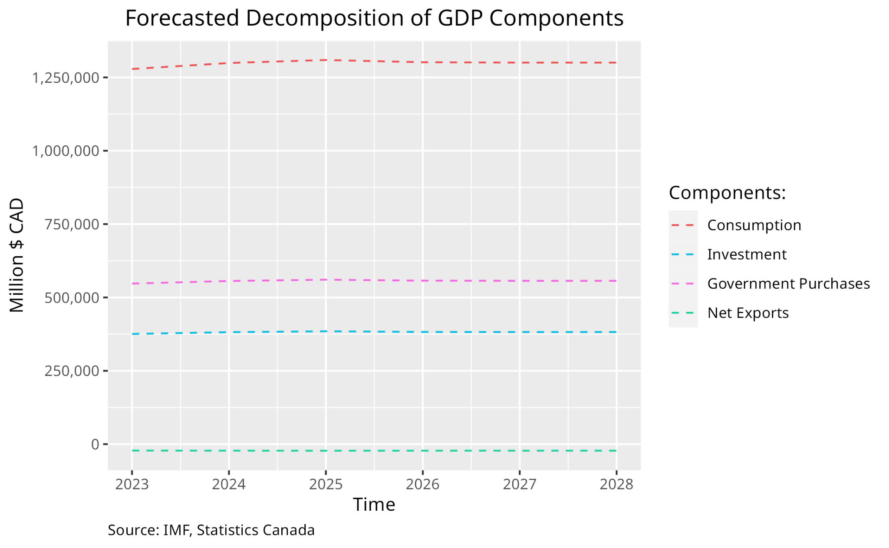
Forecasted GDP Decomposition
VAR MODEL - RESULTS

Slide 21

Risks

Slide 22
Risk: Food Inflation

Slide 23
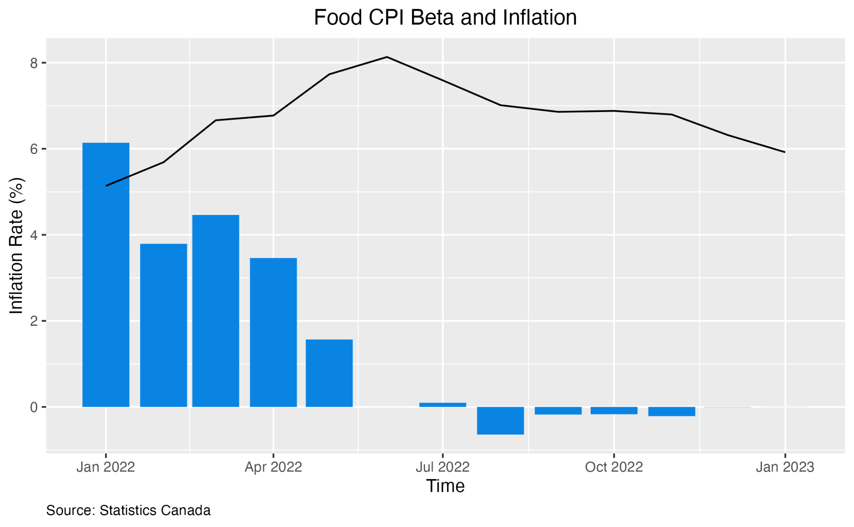
Subsiding Food Inflation
Coefficients of food inflation in our statistical model has turned insignificant
Food may not be a important driver anymore
RISK: FOOD INFLATION

Slide 24
Risk: Labour Market

Slide 25
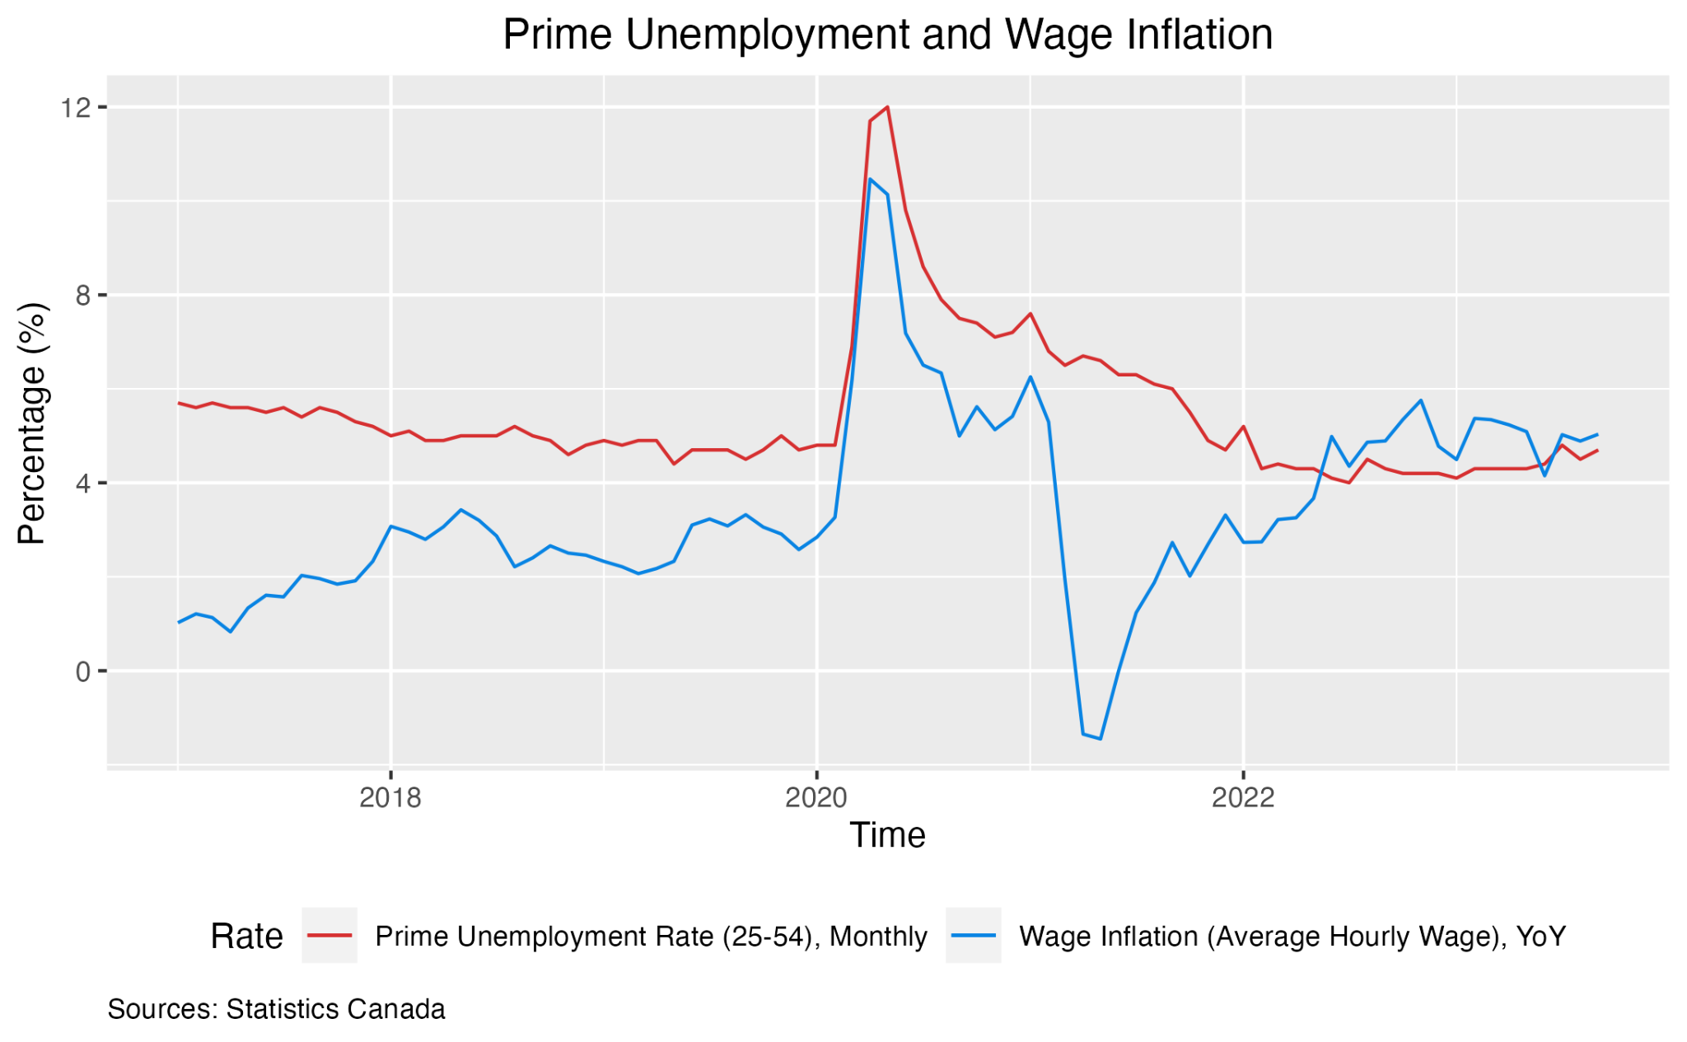
Though still historically low, labour market shows early signs of softening
Wage growth has returned to pre-pandemic levels and unemployment is slowly rising
Softer labour market may increase hesitancy to strike and would make high wage increase demands difficult
Easing Labour Market
RISK: LABOUR MARKET

Slide 26
Risk: Middle East Conflict

Slide 27
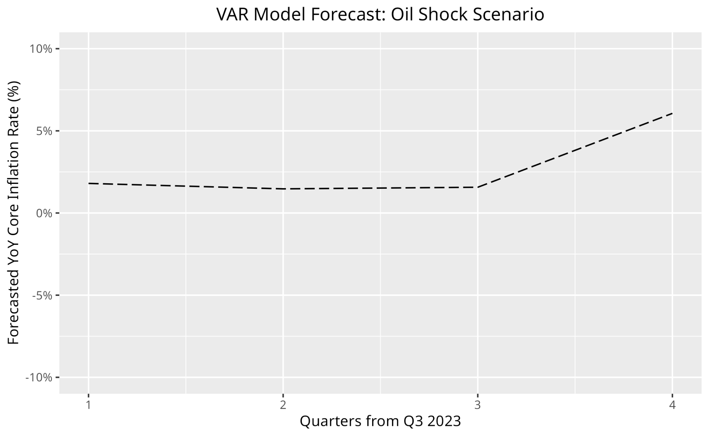
Potential escalation of recent Gaza-Israel conflict into a regional war, increasing oil prices
Oil price shock significantly increases near-term inflation in model
Middle East Conflict
RISK: MIDDLE EAST CONFLICT

Slide 28
Risk: Inflation Expectations

Slide 29
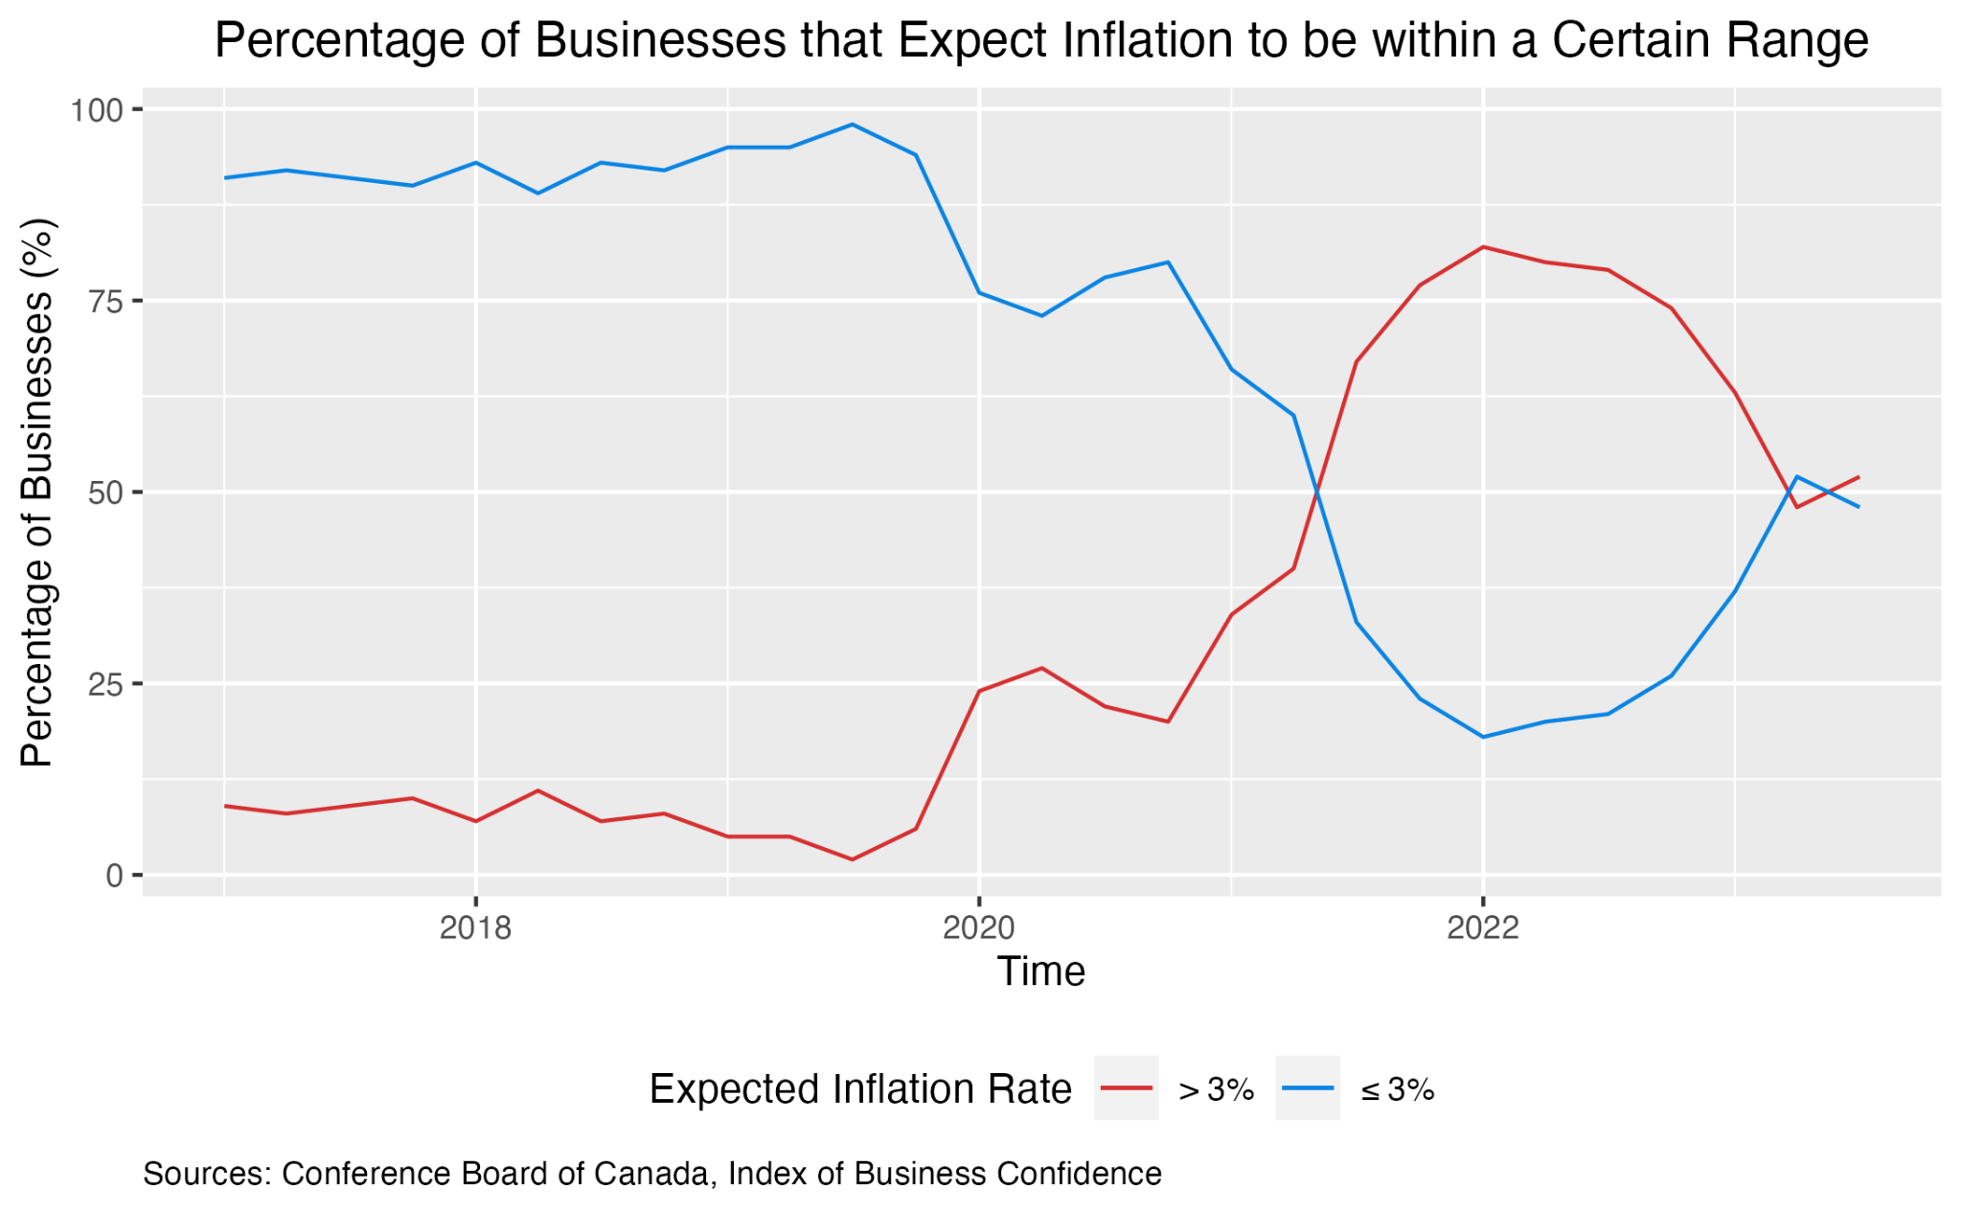
Inflation expectations by consumers and businesses have declined from their peak
Expectations stopped decreasing in latest quarter but could resume decline
Expectations could also rebound upward
Change in Expectations
RISK: INFLATION EXPECTATIONS

Slide 30
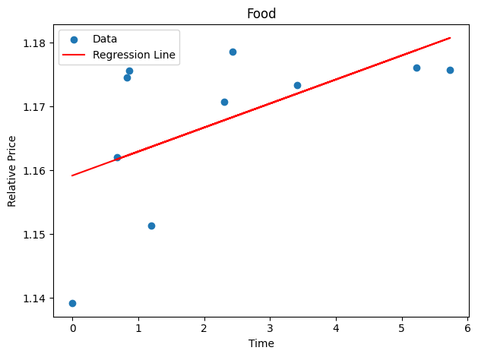
Regressed line against inflation trend
We collect residuals to form a metric of deviations from the trend of expected inflation
Softer labour market may increase hesitancy to strike and would make high wage increase demands difficult
Expected Inflation Deviations
Residual
RISK: INFLATION EXPECTATIONS

Slide 31
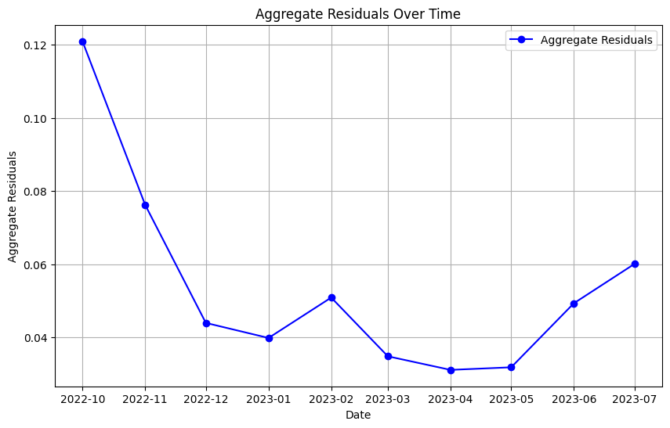
dsds
Deviations from expected inflation have fallen since the beginning of the year
This suggests actual inflation has followed expected inflation quite closely
Close to Expected Inflation
RISK: INFLATION EXPECTATIONS

Slide 32
Recommendation
Hold target rate at 5%
OUR POLICY RECOMMENDATION

Slide 33
THANK YOU!
MERCI!

Slide 34
QUESTIONS?
AVEZ-VOUS DES QUESTIONS?

